Slide 1
INTRODUCTION TO THE WEB

Slide 2
History of Web
Tim Berner-Lee Founder of WWW
Lee write the first proposal entitled “ A Large Hypertext Database with Typed links” on Nov 12,1990 at Europe
Dec 1990, Lee Developed all the tools of WWW
www stand as world web wide
The first web browser as (HTML)0.9

Slide 3
What is Web?
What is the Purpose of Web?
What is an Applications of Web?

Slide 4
Definition, scope and functions
Protocols Cyber Lows TCP/IP
Web Technologies

Slide 5
Scope of the Web Technologies
get an idea about terms in www
Identity basic steps that are followed to develop web applications
Appreciate the functionality of web browsers and web servers
Understand the layering architecture of TCP/IP
Get an overview about the IP address

Slide 6
Web Applications
Java Server Pages
Standard Tag Library
Java Server Faces
Java Server Pages
Java Servlet

Slide 7
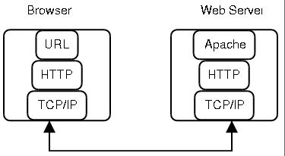
Web Architecture

